Slide 1
CS 201 – DATA STRUCTURES
LECTURE 10 : Linked List

Slide 2
Why using linked list?
Better option than arrays for inserting and deleting element-its faster.
No size limitation
But extra space is used and sequential access

Slide 3
Singly linked list
Major operations
Insertion
Deletion
Search
Incorporation of OOP
Constructor
Destructor
Copy constructor
Assignment operator

Slide 4
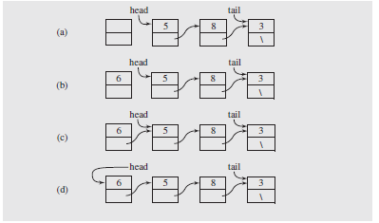
Inserting in the beginning

Slide 5
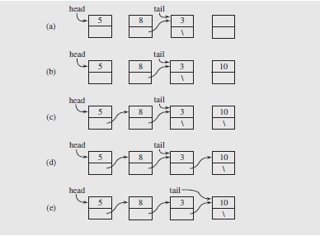
Inserting in the end

Slide 6
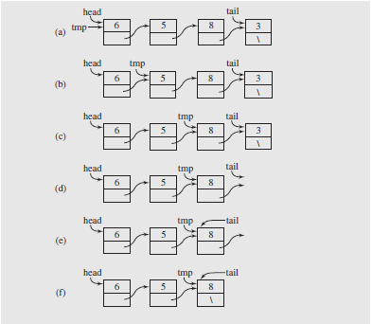
Deleting from the end

Slide 7
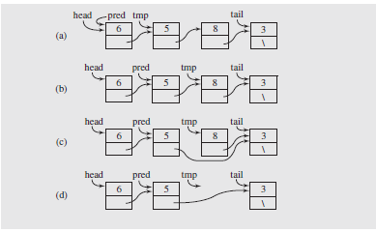
Deleting from between

Slide 8
LIMITATIONS
It can only move in one direction.
For deletion we have to traverse till the predecessor of the node to be deleted.
Insertion before a given node
Reversing a linked list

